Slide 1
Dynamic Programming-1
Lecture-6: Weighted Activity Scheduling
Md. Golam Shahriar,
Lecturer, Dept. of CSE, VU

Slide 2
Weighted Activity(interval) Scheduling
We have seen that a particular greedy algorithm produces an optimal solution to the Interval Scheduling Problem, where the goal is to accept as large a set of no overlapping intervals as possible.
The Weighted Interval Scheduling Problem is a strictly more general version, in which each interval has a certain value (or weight), and we want to accept a set of maximum value.
No greedy algorithm works for this more generalized version of the problem, which motivates us to look for a solution via dynamic programming.

Slide 3
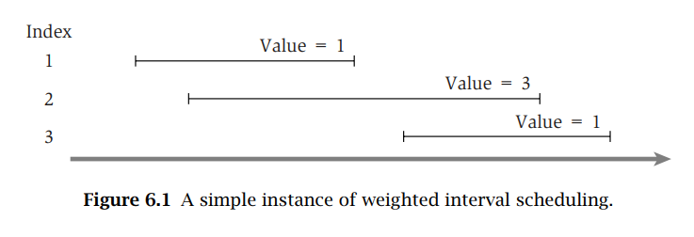

Slide 4
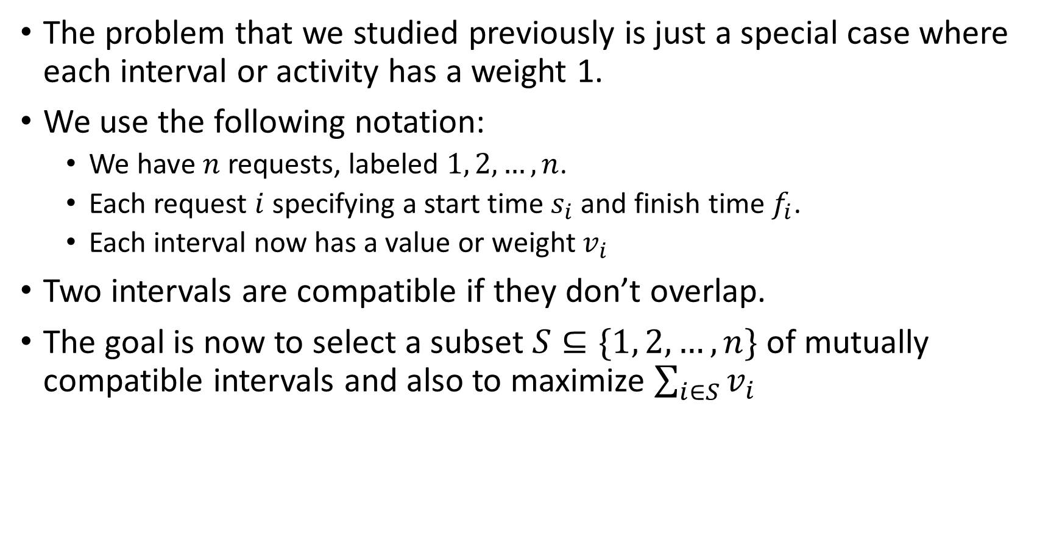
Designing a Recursive Algorithm

Slide 5
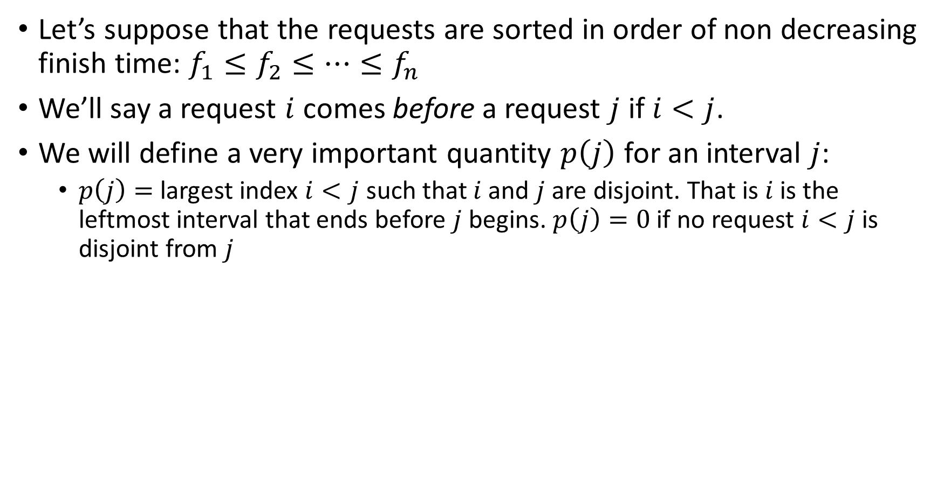
Designing a Recursive Algorithm (contd.)

Slide 6
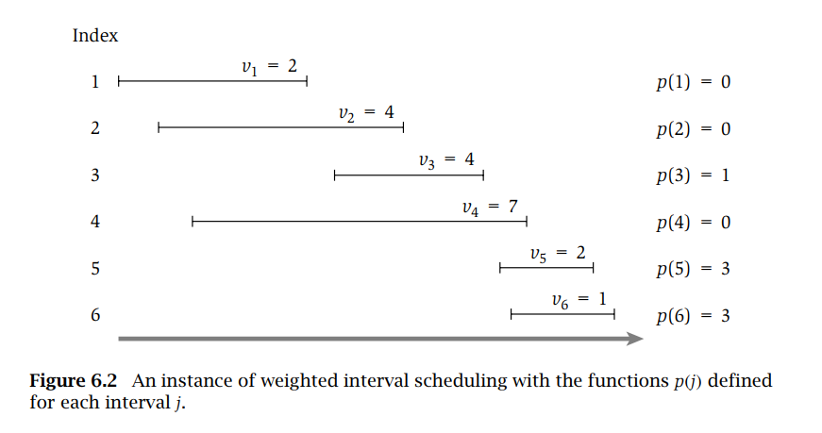

Slide 7

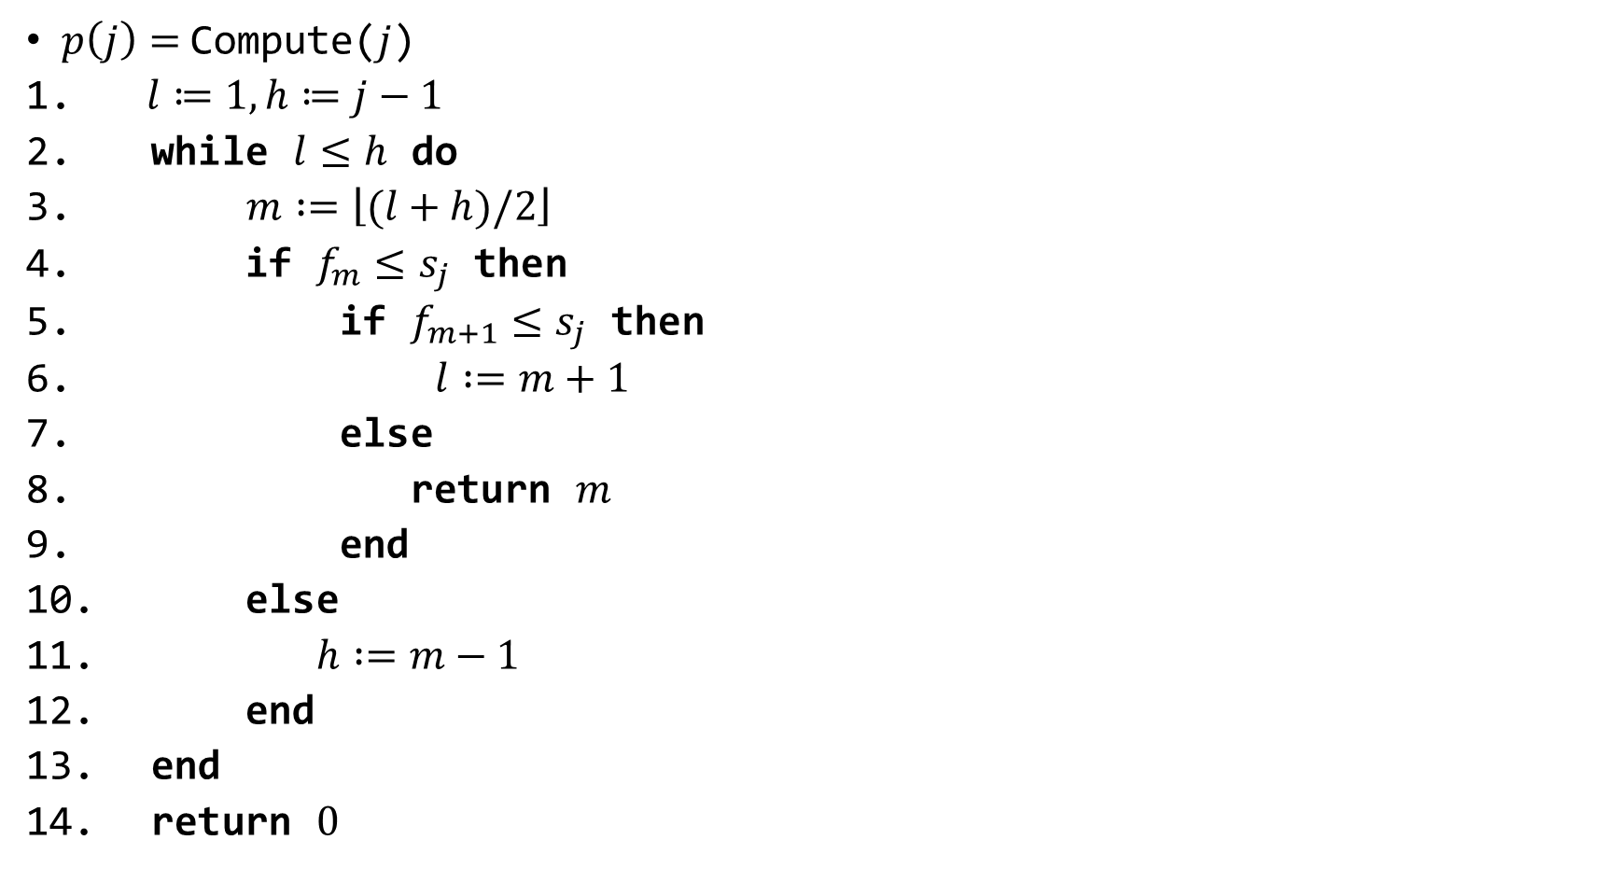

Slide 8
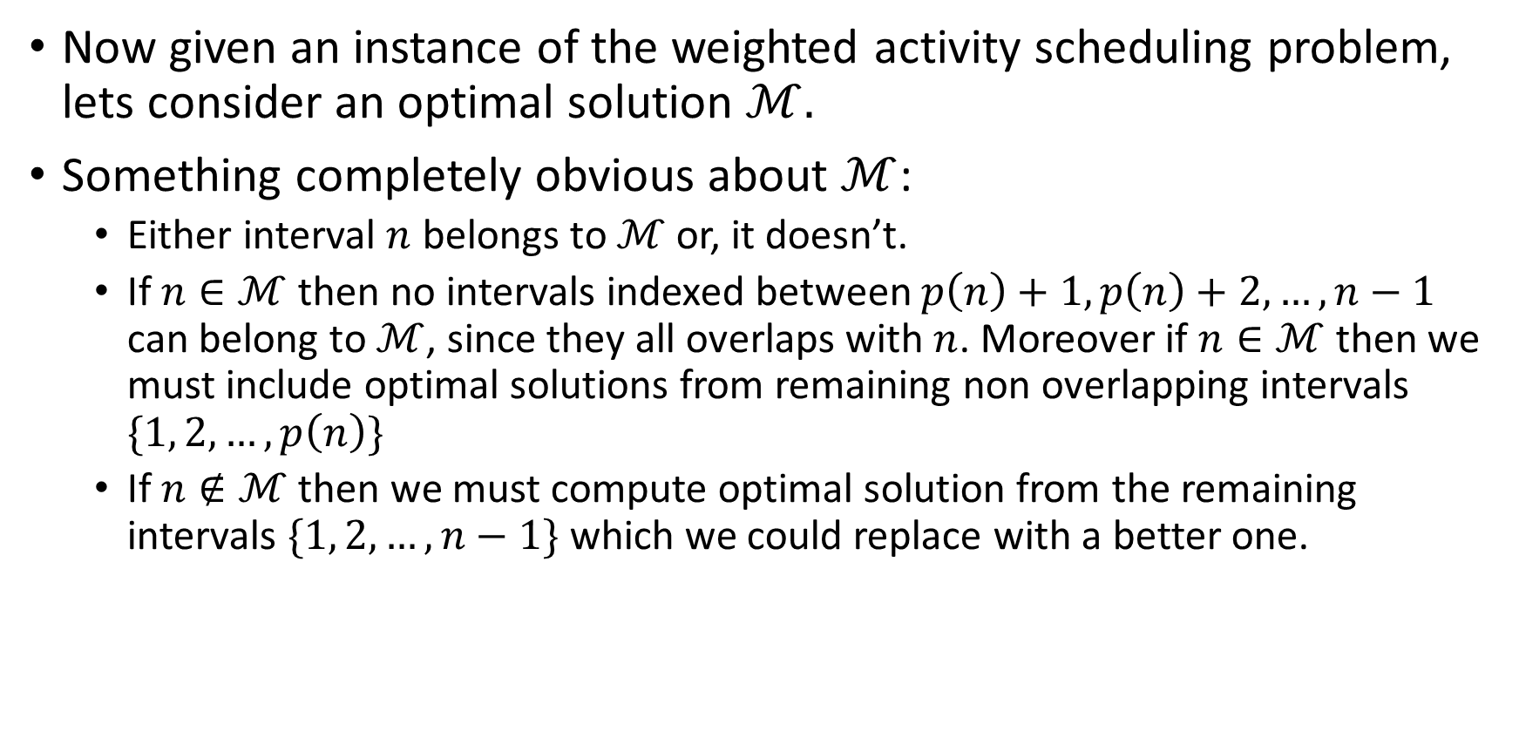
Designing a Recursive Algorithm (contd.)

Slide 9
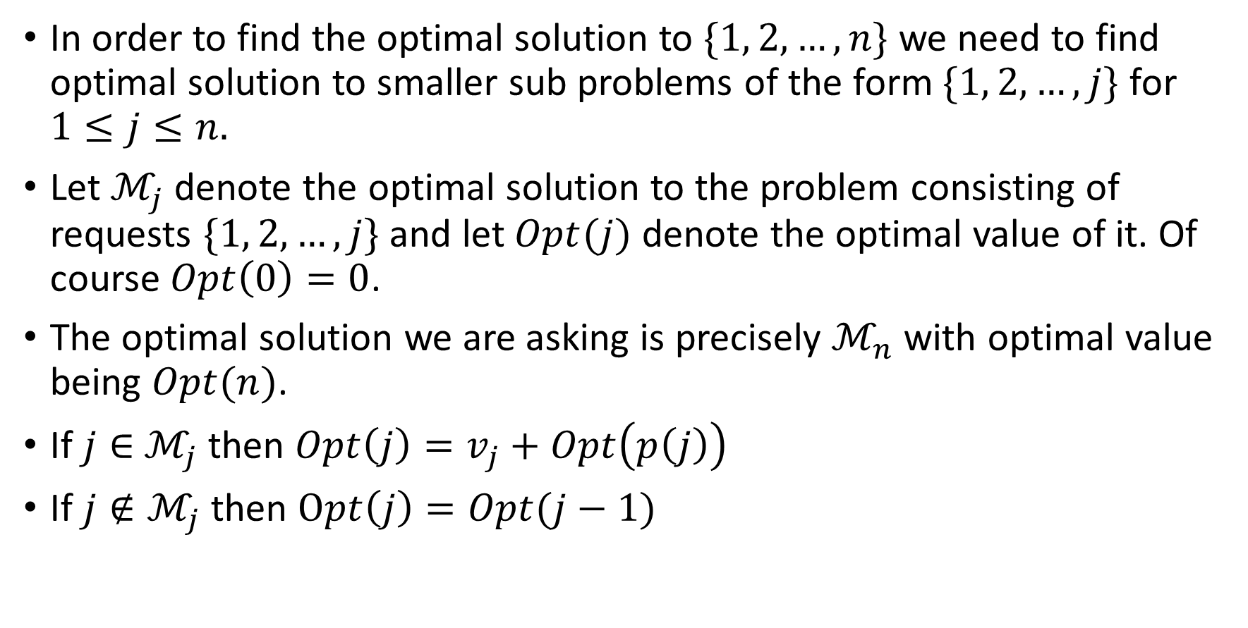
The Optimal Solution’s Computational Structure

Slide 10
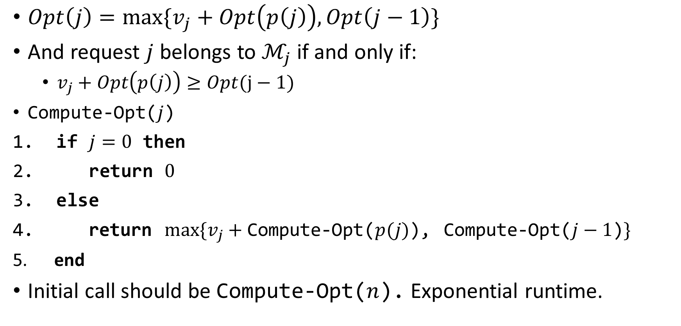
Our Recurrence Relation

Slide 11
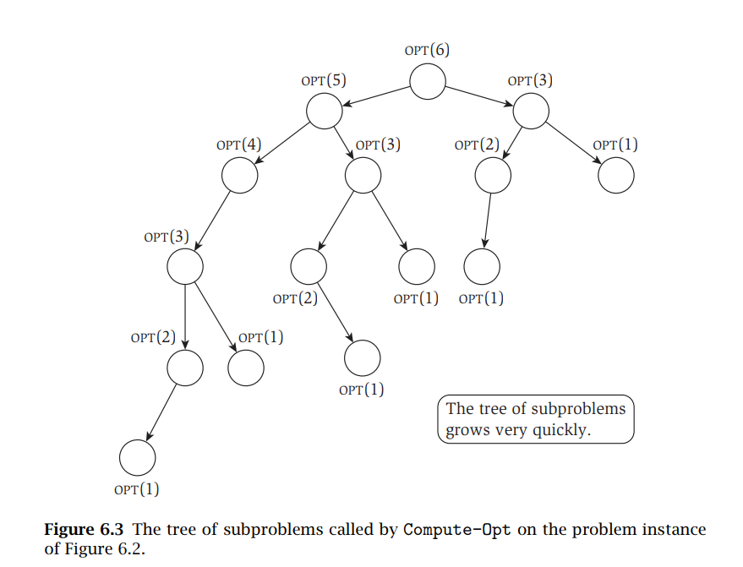

Slide 12
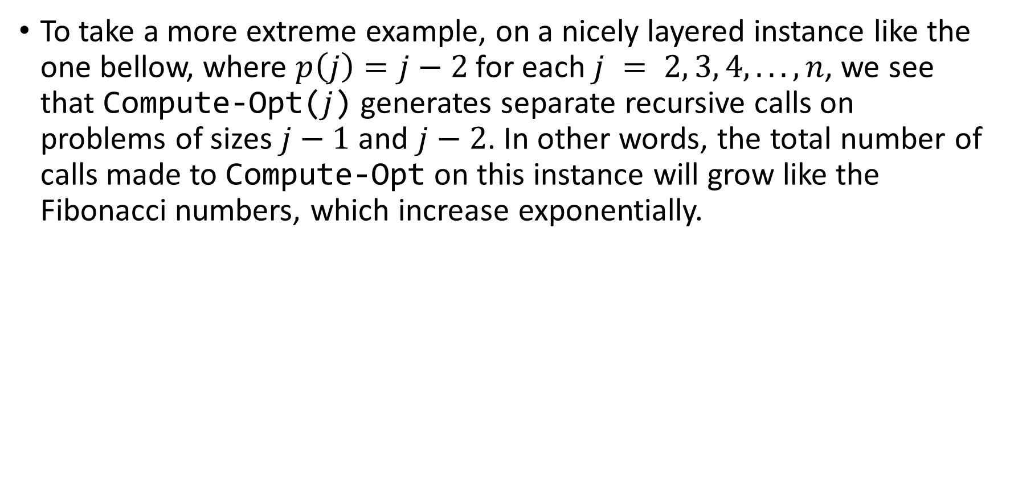
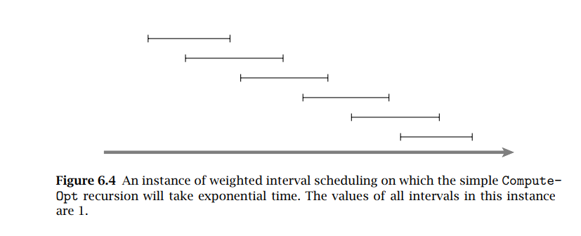
Why Native Recursive Algorithm is Bad (a worst extreme case)

Slide 13
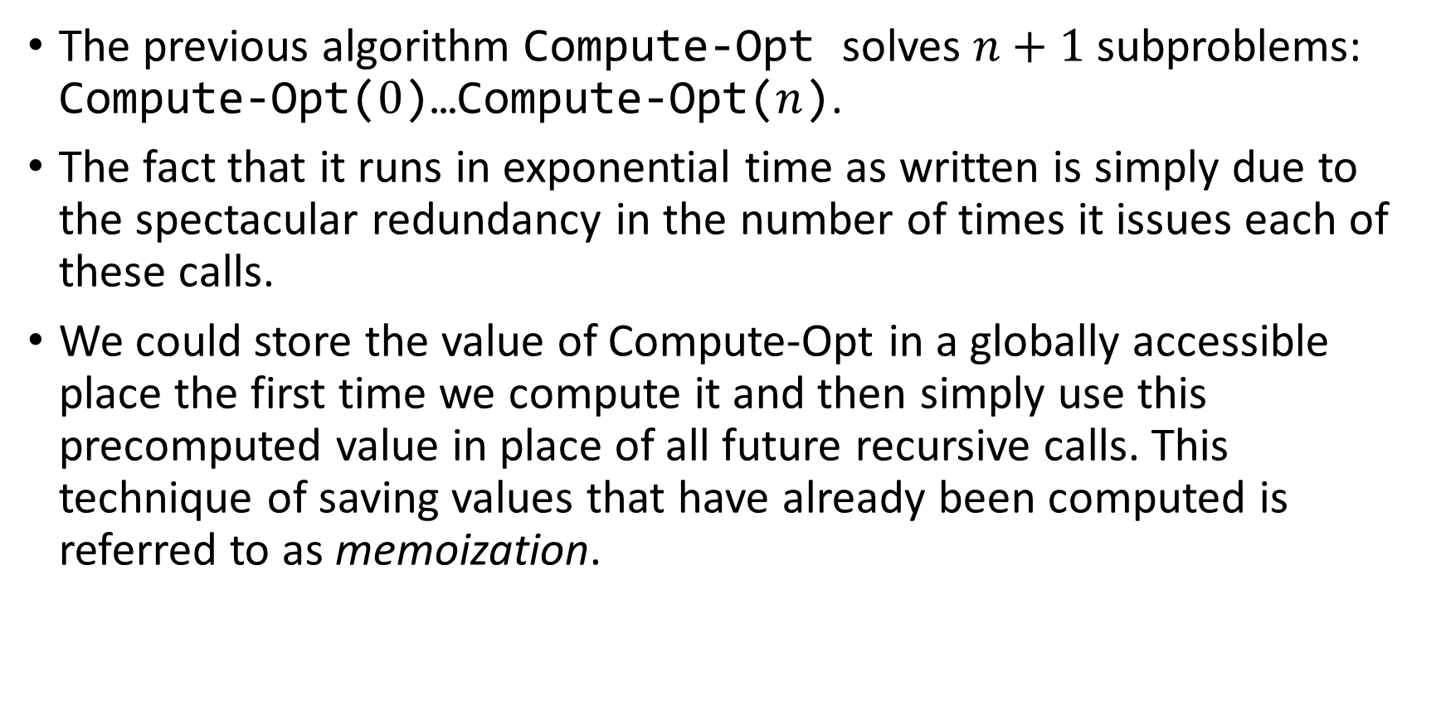
Memoizing The Recursions

Slide 14
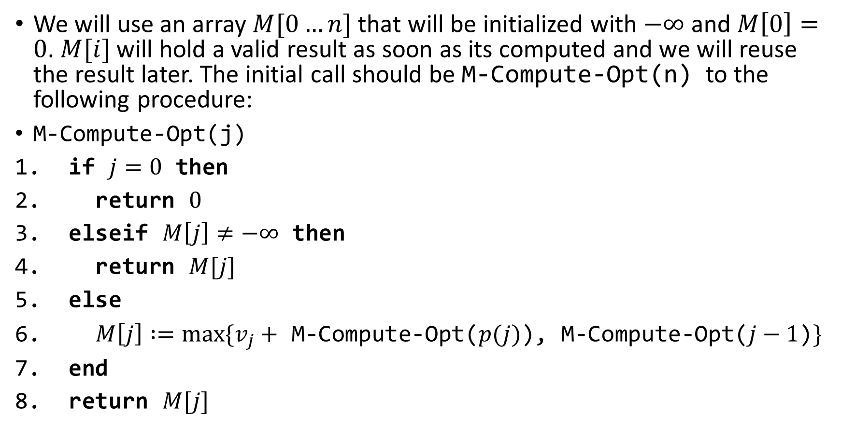
Memoizing The Recursions(contd.)

Slide 15
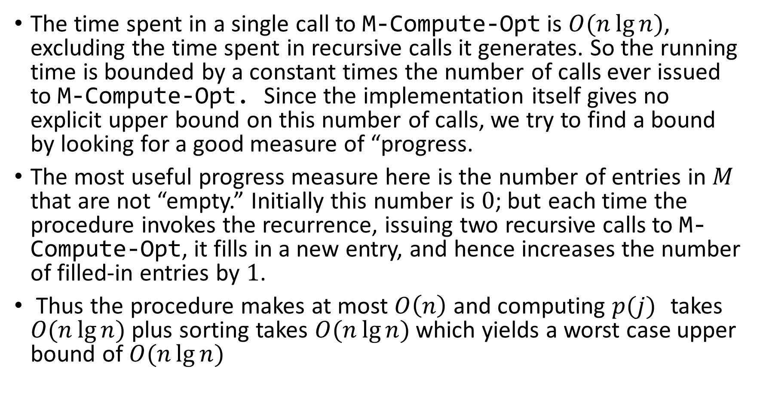
Analyzing the Memoized Version

Slide 16
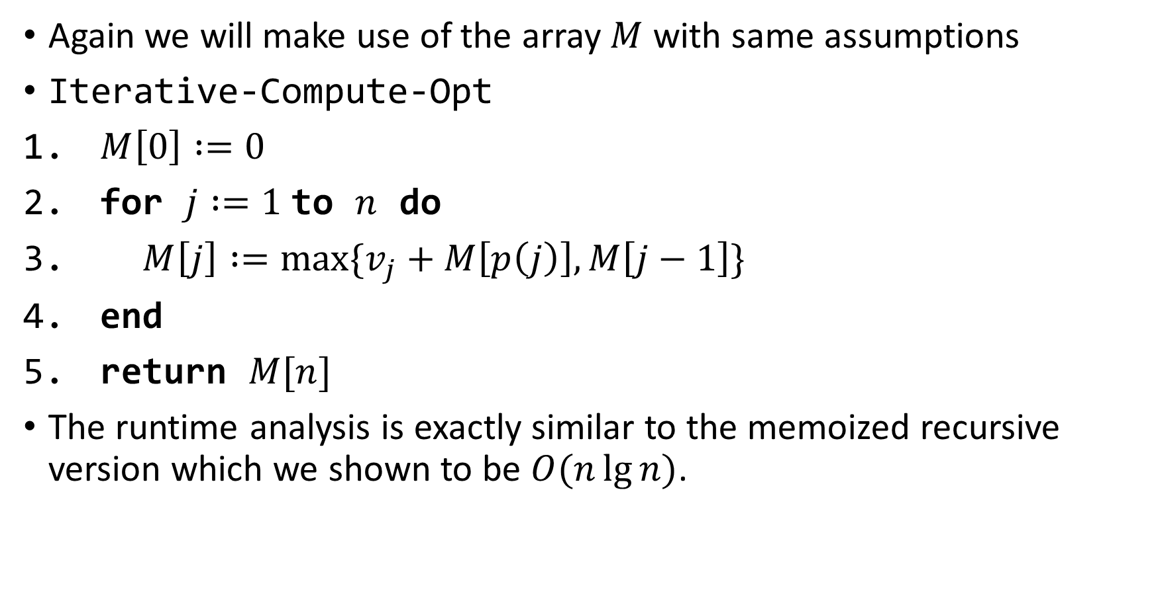
Computing the Optimal Solution Iteratively(bottom up DP)

Slide 17
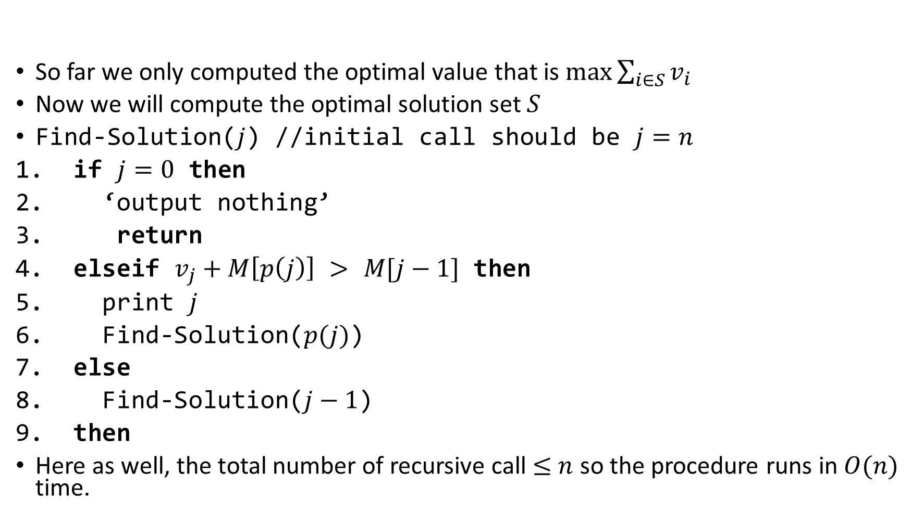
Computing Optimal Solution

Slide 18
